Slide 1
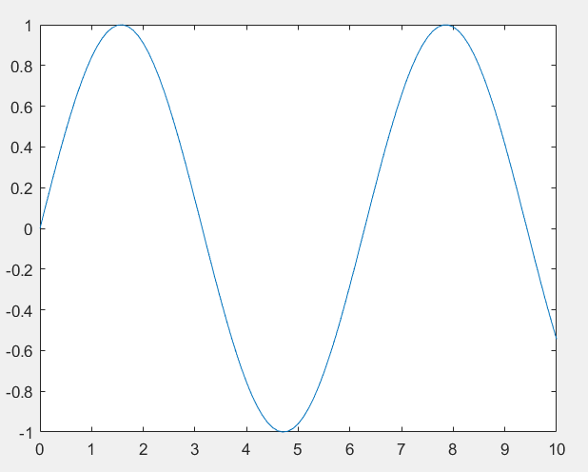
Module 3
Script file
Scripts File:
A script file is an ordinary MATLAB file that could contain any codes.
It is a sequence of MATLAB commands stored in a file (ending with .m).
It runs in the base workspace.
No inputs or outputs are formally defined.
Example of script file:
x = 0:0.1:10;
y = sin(x);
plot(x, y);
Benefits of the Script file:
Good for small tasks, plotting, and quick computations.
When you run the script file, it creates x and y plot in your workspace.

Slide 2
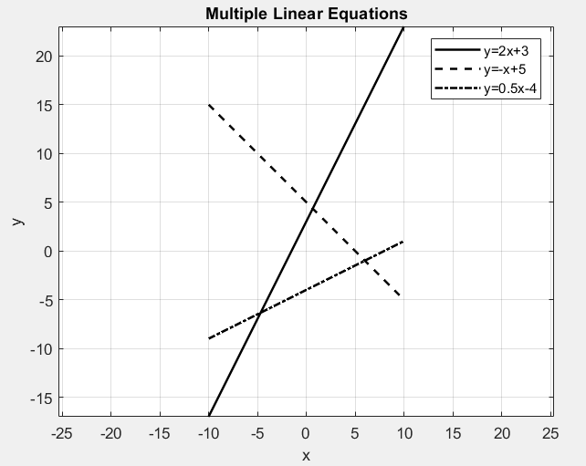
Plot multiple linear equations
y₁ = 2x + 3, y₂ = -x + 5, y₃ = 0.5x - 4
x = -10:1:10
Command:
x = -10:1:10;
y1 = 2*x + 3;
y2 = -x + 5;
y3 = 0.5*x - 4;
plot(x,y1,'k-','LineWidth',1.5);
hold on;
plot(x,y2,'k--','LineWidth',1.5);
plot(x,y3,'k-.','LineWidth',1.5);
xlabel('x'); ylabel('y');
title('Multiple Linear Equations');
legend('y=2x+3','y=-x+5','y=0.5x-4');
grid on; axis equal;

Slide 3
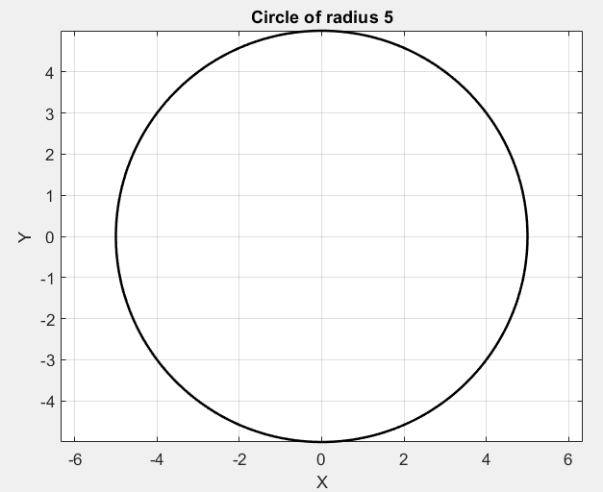
Plotting a circle
Plot a circle of Radius 5
r = 5;
theta = linspace(0,2*pi,200);
x = r*cos(theta);
y = r*sin(theta);
plot(x,y,'k-','LineWidth',1.5);
axis equal;
xlabel('X');
ylabel('Y');
title('Circle of radius 5');
grid on;

Slide 4
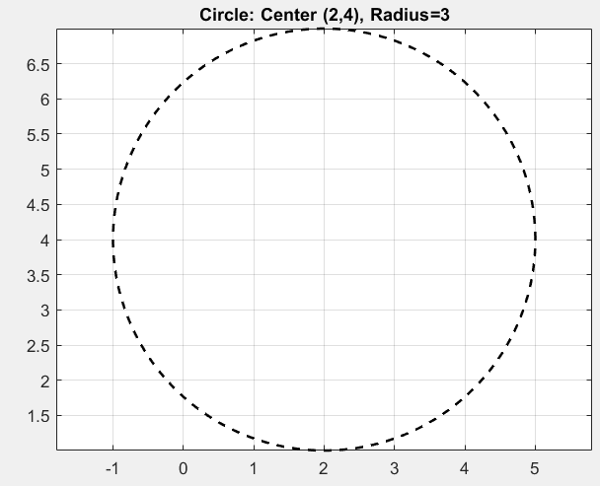
Plot a circle of Radius 3 and center (2,4)
r = 3; a = 2; b = 4;
theta = linspace(0,2*pi,200);
x = a + r*cos(theta);
y = b + r*sin(theta);
plot(x,y,'k--','LineWidth',1.5);
axis equal; grid on;
title('Circle: Center (2,4), Radius=3');

Slide 5
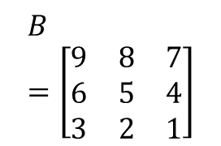
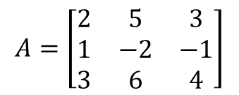
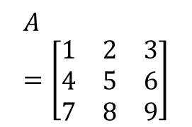
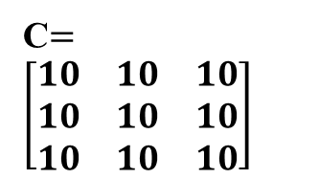


Q1. Let us write a script file to solve the following matrix addition:
Q2. Let us write a script file to solve the linear equation Ax = b.
$$A=\left[\begin{matrix}1 & 2 & 3 \\ 4 & 5 & 6 \\ 7 & 8 & 9\end{matrix}\right]$$
$$B=\left[\begin{matrix}9 & 8 & 7 \\ 6 & 5 & 4 \\ 3 & 2 & 1\end{matrix}\right]$$
$$A=\left[\begin{matrix}2 & 1 \\ 5 & 7\end{matrix}\right]$$
$$b=\left[\begin{matrix}11 \\ 13\end{matrix}\right]$$
Script
A = [1 2 3; 4 5 6; 7 8 9];
B = [9 8 7; 6 5 4; 3 2 1];
C = A + B;
disp('A + B =‘);
disp(C);
Answer:
Script
A = [2 1; 5 7];
b = [11; 13];
x = A\b;
disp('Solution x:’);
disp(x);
C$=\left[\begin{matrix}10 & 10 & 10 \\ 10 & 10 & 10 \\ 10 & 10 & 10\end{matrix}\right]$
Answer:
x = 7.1111
-3.2222
Q3. Let us write a script file to solve the following matrix determinant
Script
A = [2 5 3; 1 -2 -1; 3 6 4];
d = det(A);
disp('Matrix A:'); disp(A);
disp(['Determinant of A = ', num2str(d)]);
Answer:
det (A) = -3
$$A=\left[\begin{matrix}2 & 5 & 3 \\ 1 & −2 & −1 \\ 3 & 6 & 4\end{matrix}\right]$$

Slide 6
Q4. Write a MATLAB script file to calculate the area of a circle when the radius = 5 cm. Display the result.
Q6. Write a MATLAB script file to compute the work done when a force of 100 N moves a body through a displacement of 20 m.
Solution:
% Script to calculate area of a circle
r = 5; % radius
A = pi * r^2;
disp(['Area of circle = ', num2str(A)]);
Solution:
% Script to calculate work done
F = 100; % Force in N
d = 20; % displacement in m
W = F * d;
disp(['Work done = ', num2str(W), ' J']);
Q5. Develop a MATLAB script to compute the speed of a vehicle given distance = 120 m and time = 10 s.
Solution:
% Script to calculate speed
distance = 120; % in meters
time = 10; % in seconds
speed = distance / time;
disp(['Speed = ', num2str(speed), ' m/s']);

Slide 7
Q8. Write a MATLAB script file to calculate the rate of heat transfer by conduction when:
Thermal conductivity k = 200 W/mK
Cross-sectional area A = 0.01 m²
Temperature difference ΔT = 50 K
Thickness dx = 0.1 m
Q7. Write a MATLAB script file to calculate the stress in a material when the applied force is 500 N and the cross-sectional area is 50 mm²
Solution:
% Script to calculate stress
F = 500; % Force in N
A = 50; % Area in mm^2
stress = F / A;
disp(['Stress = ', num2str(stress), ' N/mm^2']);
Solution:
% Script to calculate conduction heat transfer
k = 200; % Thermal conductivity W/mK
A = 0.01; % Area in m^2
dT = 50; % Temperature difference K
dx = 0.1; % Thickness in m
Q = (k * A * dT) / dx;
disp(['Heat Transfer Rate = ', num2str(Q), ' W']);

Slide 8
Caution:
NEVER name a script file the same as the name of a variable it computes. If a variable of the same name as the script file exists, MATLAB will never be able to access the script file.
The name of a script file must begin with a letter. The rest of the characters may include digits and the underscore character. You may give long names, but MATLAB will take only the first 19 characters. Thus, names such as projecL23C.m and cee213_hw5_1.m are fine, but project.23C.m and cee213_hw5.1.m are not valid names.

Slide 9




Questions for Practice
Using Script File:
Sum of the first 100 natural numbers.
Solve the System of Linear Equations Ax=b, and find the value of x.
Matrix Multiplication of the following matrix.
Write a MATLAB script to find the maximum element in an array of numbers. A = [12, 45, 7, 89, 23]
Write a MATLAB script file to calculate the power transmitted by a rotating shaft when the torque is 200 Nm and the speed is 1500 rpm.
Write a MATLAB script to calculate the strain when the change in length is 0.5 mm and the original length is 100 mm.
Write a MATLAB script to calculate the efficiency of a machine when the input power is 1000 W and the output power is 850 W.
$$A=\left[\begin{matrix}3 & 6 \\ 8 & 9\end{matrix}\right]$$
$$b=\left[\begin{matrix}15 \\ 18\end{matrix}\right]$$
$$A=\left[\begin{matrix}1 & 2 \\ 3 & 4\end{matrix}\right]$$
$$B=\left[\begin{matrix}2 & 0 \\ 1 & 3\end{matrix}\right]$$

Slide 10
Function File
As seen in the previous section, a script file can contain a locally declared function. Whereas a function in MATLAB is defined more globally by creating it in its specified file.
A function is a more structured program stored in a .m file.
It has its own workspace.
It can accept input arguments and return output values.
A file that contains a function only needs to fulfil the following conditions:
Only one parent function is allowed per file.
The file name must be the same as the function name.
A function file begins with the keyword function. Unlike scripts, functions have their own local workspace, which means variables inside a function do not interfere with the base workspace. Best for reusable code, large projects

Slide 11
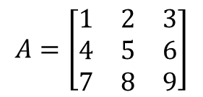
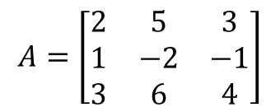
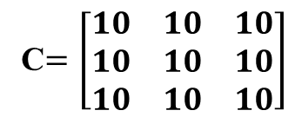
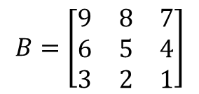
function [output variable] = function_name(input variables);
$$A=\left[\begin{matrix}2 & 5 & 3 \\ 1 & −2 & −1 \\ 3 & 6 & 4\end{matrix}\right]$$
Example: Function file to solve the following matrix addition:
Example:
Find the det(A).
Solution:
function d = determinant3x3(A)
A = [2 5 3; 1 -2 -1; 3 6 4];
d = det(A);
end
Answer: -3
Example: Find the value of y from the given equation, when x = 0:10
function y = myfunction(x)
x = 0:10;
y = x.^2 - 10.*x + 15;
end
$$A=\left[\begin{matrix}1 & 2 & 3 \\ 4 & 5 & 6 \\ 7 & 8 & 9\end{matrix}\right]$$
$$B=\left[\begin{matrix}9 & 8 & 7 \\ 6 & 5 & 4 \\ 3 & 2 & 1\end{matrix}\right]$$
function C = matrixaddition(A,B)
A = [1 2 3; 4 5 6; 7 8 9];
B = [9 8 7; 6 5 4; 3 2 1];
C = A + B;
disp('A + B =C‘);
disp(C);
Answers:
15 6 -1 -6 -9 -10 -9 -6 -1 6 15
Answer:
C$=\left[\begin{matrix}10 & 10 & 10 \\ 10 & 10 & 10 \\ 10 & 10 & 10\end{matrix}\right]$

Slide 12
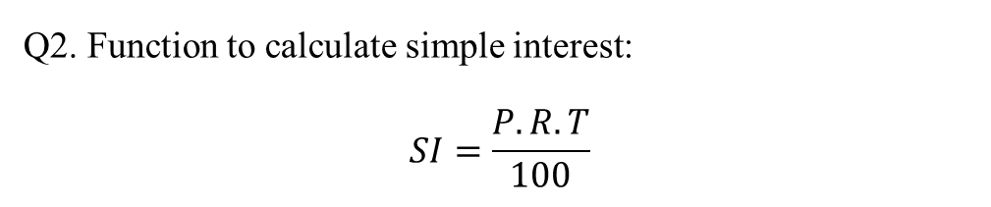
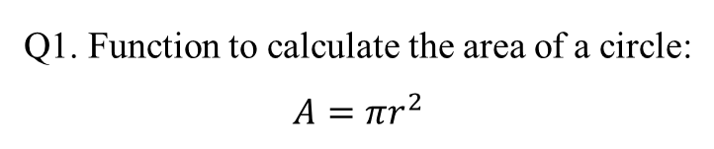
Examples
Q1. Function to calculate the area of a circle:
$$A=πr^{2}$$
Q2. Function to calculate simple interest:
$$SI=\frac{P.R.T}{100}$$
Solution:
function A = circleArea(r)
A = pi * r^2;
end
Save it, and call with:
area = circleArea(5)
Answer: 78.5398
Solution:
function SI = simpleInterest(P, R, T)
SI = (P*R*T)/100;
end
Save it, and call with
si = simpleInterest(1000,5,2)
Answer: 100

Slide 13
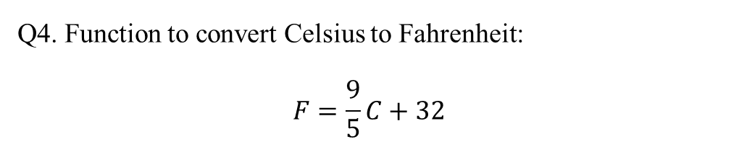
Examples
Q3. Write a function file that takes a number as input and returns its square.
Q4. Function to convert Celsius to Fahrenheit:
$$F=\frac{9}{5}C+32$$
Solution:
function y = squareNum(x)
y = x^2;
end
Save it, and call with:
result = squareNum(10)
Answer: 100
Solution:
function F = celsiusToFahrenheit(C)
F = (9/5)*C + 32;
end
Save it, and call with:
tempF = celsiusToFahrenheit(25)
Answer: 77

Slide 14




Questions for Practice
Using Function file:
1. Sum of the first 50 natural numbers
2. Solve the System of Linear Equations Ax=b, and find the value of x.
3. Matrix Multiplication of the following matrix
$$A=\left[\begin{matrix}2 & 1 \\ 5 & 7\end{matrix}\right]$$
$$b=\left[\begin{matrix}11 \\ 13\end{matrix}\right]$$
$$A=\left[\begin{matrix}6 & 3 \\ 8 & 7\end{matrix}\right]$$
$$B=\left[\begin{matrix}5 & 3 \\ 9 & 2\end{matrix}\right]$$
4. What is a MATLAB function file? How is it different from a script file?
5. Why do we use function files instead of scripts in MATLAB?
6. Write a function file to calculate the average of three numbers: 15, 25 and 40.
7. Write a function file to calculate the sum of the first n numbers.

